Slide 1
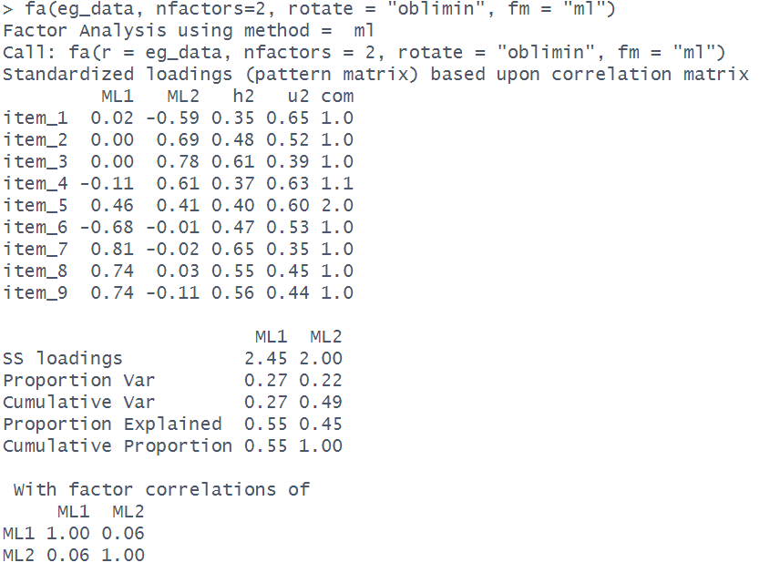
PATTERN MATRIX
Each column is a factor (these are named according to the extraction method)
Each row is an item (one of our variables)

Slide 2
PATTERN MATRIX
Each column is a factor (these are named according to the extraction method)
Loadings show the association between each item and each factor.
With an oblique rotation, the pattern matrix shows standardised regression coefficients:
item_{i} = loading_{F1,i}*Factor1 + loading_{F2,i}*Factor2 + … + uniqueness_{i}
With no rotation or an orthogonal rotation these are correlation coefficients, and the pattern matrix is identical to the structure matrix*
Each row is an item (one of our variables)
A squared loading reflects the proportion of variance in an item that is uniquely explained by a factor.
e.g., -0.59² = 0.35
35% of the variance in item 1 is explained by Factor 2
*When an oblique rotation is used, factors can be correlated. Therefore to get the unique association between item and factors, we need the regression weights from a model of item ~ factor1 + factor2.
If the factors are not correlated (by definition they are uncorrelated when no rotation or an orthogonal rotation is used), then these regression weights are just the same as the correlations cor(item, factor1) and cor(item, factor2).

Slide 3
COMMUNALITIES
Square the correlations each item and add them up, and you get the proportion of variance in an item that is explained by all the factors. This is the “communality”.
The correlations are in the structure matrix,
but this is the pattern matrix. Because the factor correlations here are low, we can just do this calculation on the loadings here
e.g., -0.11² + 0.61² = approx 0.37
37% of the variance in item 4 is explained by this 2 Factor solution

Slide 4
UNIQUENESS
The proportion of variance in each item that is left unexplained by the factors is 1 minus the communality.
e.g., 1 - 0.37 = 0.63
63% of the variance in item 4 is left unexplained

Slide 5
COMPLEXITY
The extent to which a given item loads on to a single factor vs onto multiple factors is termed ‘complexity’.
It equals 1 if an item loads only on one factor, 2 if it loads evenly on 2 factors, and so on.

Slide 6
SS Loadings & “Variance Accounted For”
Square all the loadings for each factor and add them up. This gives you the “SS loadings”.
These are the same as the eigenvalues unless an oblique rotation is used. As the variance in each item is scaled to be 1, the total variance in the data is equal to the number of items.

Slide 7
SS Loadings & “Variance Accounted For”
SS loadings divided by number of items gives the proportion of variance in the data explained by each factor
e.g., 2.45/9 = 0.27
27% of the variance is explained by Factor 1

Slide 8
SS Loadings & “Variance Accounted For”
Taking each factor sequentially, we can calculate the cumulative variance explained.
e.g., 0.27+0.22 = 0.49

Slide 9
SS Loadings & “Variance Accounted For”
Out of the total variance explained by all factors, we can calculate the proportion of this that is explained by each factor.
e.g., 0.27/0.49 = 0.55
We can see this cumulatively too

Slide 10
FACTOR CORRELATIONS
Correlation matrix for the factors. This will depend on whether or not a correlation is estimated (i.e. whether an oblique rotation is used). Shows how related the factors are to one another.

Slide 11
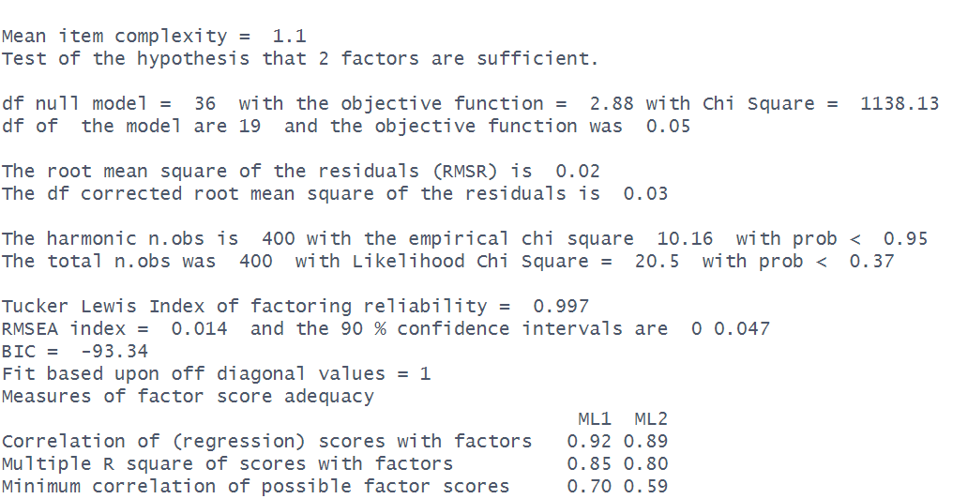
OPTIONAL EXTRA: GOODNESS OF FIT TEST
Mean of the item complexities column
the “null model” is a model that assumes no correlation structure. df = p * (p-1)/2
p = number of items
our model df = p * (p-1)/2 - p * nF + nF*(nF-1)/2
p = number of items
nF = number of factors
Chi-square ‘goodness of fit’ for our model (calculated two ways, see ?factor.stats ). The set of parameters from our model implies a correlation matrix, and we have our observed matrix. The discrepancy between these is the residual correlation matrix, and it is on this that the Chi-Square statistic is based (think “observed minus expected”).
Lower Chi-Square values are better. A significant Chi-square value indicates possible under-extraction of factors.
average number of non-missing observations for each pair of items
Total number of observations in the data

Slide 12
OPTIONAL EXTRA: FIT INDICES
All of these are essentially measure of how well (or how badly) the model fits to the observed data. They are more conventionally used in confirmatory factor analysis (CFA) and structural equation modelling (SEM), but are printed here too.
We want RMSR to be low (it indicates the average size of the residual correlation)
Tucker Lewis Index (TLI) compares the chi-square of our model to that of the null model (adjusted for the df). It ranges 0 to 1, and we want it to be high. Typical cut-offs used to indicate good fit are >0.9 or >0.95.
RMSEA is a measure of how far our model is from a ‘perfect model’. Lower is better, and typical cut-offs used to indicate good fit are <0.05, <0.08 or <0.1.
BIC is only relevant for comparing models

Slide 13
OPTIONAL EXTRA: INDETERMINACY INDICES
“Factor score indeterminacy”: there are an infinite number of pairs of factor loadings and factor score matrices which will fit the data equally well, and are thus indistinguishable by any numeric criteria, so there are infinite number of sets of factor scores that are consistent with a given set of loadings.
Multiple R square of scores with factors “The multiple R² between the factors and factor score estimates, if they were to be found." (Grice, 2001). This is a little bit like the R² for a regression model of the items predicting the estimated factor score. If we could perfectly predict factor scores from items, then it would be 1.
Correlation of (regression) scores with factors This just the square root of the multiple R².
Minimum correlation of possible factor scores This is 2 x R² – 1, so essentially the R² but transformed to be between -1 and 1.

Slide 14
set.seed(533)
makeitems <- function(){
S = runif(5,.4,2)
f = runif(5,.4,.99)
R = f %*% t(f)
diag(R) = 1
items = round(MASS::mvrnorm(400, mu = rnorm(5,3,.6), Sigma=diag(S)%*%R%*%diag(S)))
apply(items, 2, function(x) pmin(7,pmax(1,x)))
}
eg_data = do.call(cbind,lapply(1:2, function(x) makeitems()))
eg_data[,5] <- round(rowMeans(eg_data[,c(5,10)]))
eg_data <- eg_data[,-10]
eg_data[,1] <- max(eg_data[,1]) - eg_data[,1] + 1
eg_data[,6] <- max(eg_data[,6]) - eg_data[,6] + 1
eg_data <- as.data.frame(eg_data)
names(eg_data) <- paste0("item_",1:9)
mm = fa(eg_data, nfactors=2, rotate = "oblimin", fm="ml")
mm
# tli
((1138.13/36) - (20.71/19)) /
((1138.13/36) - 1)
# rmsea
sqrt(20.71 - 19) /
sqrt(19*(400-1))

